Slide 1
JAVA I/O
Streams

Slide 2
I/O
Usual Purpose: storing data to ‘nonvolatile‘ devices, e.g. harddisk
Classes provided by package java.io
Data is transferred to devices by ‘streams‘
output - stream
Program
Device
input - stream
input - stream
Program
Device

Slide 3
Streams
JAVA distinguishes between 2 types of streams:
1) Text – streams, containing ‘characters‘
Program
Device
Device
Device
I
‘
M
A
S
T
R
I
N
G
\n
Device
2) Binary Streams, containing 8 – bit information
Program
01101001
11101101
00000000
Device

Slide 4
Streams
Streams in JAVA are Objects. Having
2 types of streams (text / binary) and
2 directions (input / output)
results in 4 base-classes dealing with I/O:
Reader : text-input
Writer : text-output
InputStream : byte-input
OutputStream : byte-output

Slide 5
Text or binary
If you use binary data, such as integers or doubles, then use the InputStream and
OutputStream classes.
If you are using text data, then the Reader and Writer classes are right.

Slide 6
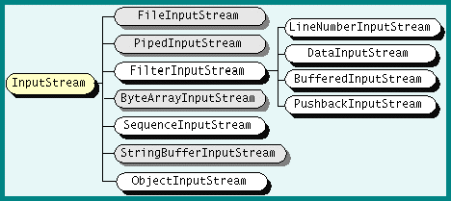
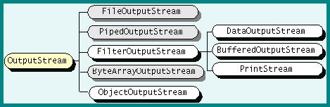

Slide 7
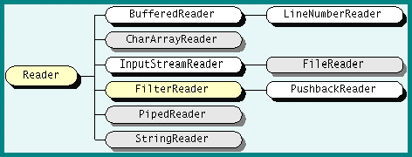
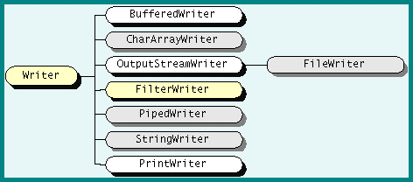

Slide 8
InputStream Methods
int read()
Reads a byte of data. And returns the byte read, or -1 if the end of the stream is reached.
long skip(long n)
Skips n bytes of input. And returns the actual number of bytes skipped.
int available()
Returns the number of bytes that can be read
void close()
Closes the input stream.

Slide 9
FileInputStream
The FileInputStream class represents a byte stream that reads data from a file.
Its two most common constructors are shown here:
FileInputStream(String filepath)
FileInputStream(File fileObj)
Example:
FileInputStream f0 = new FileInputStream("c://myfolder//myfile.txt");
File f = new File("c://myfolder//myfile.txt");
FileInputStream f1 = new FileInputStream(f);

Slide 10
FileInputStream Example
import java.io.*;
class FileInputStreamDemo {
public static void main(String[] args)throws IOException {
File file = new File("/root/demo.txt");
int ch;
FileInputStream fin=new FileInputStream(file);
System.out.println("File contents :");
while( (ch = fin.read()) != -1)
System.out.print((char)ch);
fin.close();
} }

Slide 11
ByteArrayInputStream
A ByteArrayInputStream is a stream whose data comes from a byte array.
The data comes from an array instead of an actual I/O device.
Constructors:
ByteArrayInputStream(byte[] buf)
ByteArrayInputStream(byte[] buf,int offset,int length)
buf-The stream source.
offset-An index into the buffer where the stream should begin.
length- The number of bytes to read.

Slide 12
ByteArrayInputStream Example
import java.io.*;
class FileInputStreamDemo {
public static void main(String[] args)throws IOException {
byte b[]={'a','b',99,100};
ByteArrayInputStream in=new ByteArrayInputStream(b);
int ch;
while((ch=in.read())!=-1)
System.out.print((char)ch);
in.close();
}}
abcd

Slide 13
OutputStream Methods
void write(int b)
Writes a byte.
void close()
Closes the stream.

Slide 14
FileOutputStream
FileOutputStream(File)
FileOutputStream(String)

Slide 15
FileOutputStream Example
import java.io.*;
class Demo {
public static void main(String[] args)throws IOException {
File file = new File("/root/demo1.txt");
int ch;
FileOutputStream fout=new FileOutputStream(file);
fout.write('a');
fout.write(97);
fout.write(98);
fout.close();
} }

Slide 16
ByteArrayOutputStream
A ByteArrayOutputStream is a stream whose data is written to an internal byte array.
The data is written to an array instead of an actual I/O device.
Constructor:
ByteArrayOutputStream()

Slide 17
ByteArrayOutputStream Example
import java.io.*;
class Demo {
public static void main(String[] args)throws IOException {
ByteArrayOutputStream out=new ByteArrayOutputStream();
out.write(97);
out.write('b');
out.close();
System.out.println(out);
}}
ab

Slide 18
FileReader
import java.io.*;
class demo{
public static void main(String args[])throws IOException{
FileReader fr=new FileReader("/root/demo.txt");
int ch;
while((ch=fr.read())!=-1)
System.out.print((char)ch);
} }

Slide 19
FileWriter
import java.io.*;
class demo{
public static void main(String args[])throws IOException{
FileWriter fw=new FileWriter("/root/demo1.txt");
fw.write("Example for file writer");
fw.close();
}
}

Slide 20
CharArrayReader
import java.io.*;
public class Main {
public static void main(String[] args)throws IOException {
char c[]={'a','b','c'};
CharArrayReader cr=new CharArrayReader(c);
int ch;
while((ch=cr.read())!=-1)
System.out.print((char)ch);
}
}
abc

Slide 21
CharArrayWriter
import java.io.*;
public class Main {
public static void main(String[] args)throws IOException {
char c[];
CharArrayWriter cr=new CharArrayWriter();
cr.write("Example");
System.out.println(cr);
}
}
Example

Slide 22
Java - Serialization
Java provides a mechanism, called object serialization where an object can be represented as a sequence of bytes that includes the object's data as well as information about the object's type and the types of data stored in the object.
After a serialized object has been written into a file, it can be read from the file and deserialized that is, the type information and bytes that represent the object and its data can be used to recreate the object in memory.

Slide 23
ObjectOutputStream
The ObjectOutputStream class contains write method for writing.
void writeObject(Object x)
The above method serializes an Object and sends it to the output stream.

Slide 24
ObjectInputStream
The ObjectInputStream class contains the following method for deserializing an object:
Object readObject()

Slide 25
Serializing & Deserializing an Object
import java.io.*;
class demo implements Serializable{
String name;int age;
demo(){
name="ABC";
Age=23; } }
class SerializeDeserializeDemo{
public static void main(String [] args)throws Exception{
demo d=new demo();
FileOutputStream fout=new FileOutputStream("/root/myfile.txt");
ObjectOutputStream objout=new ObjectOutputStream(fout);
objout.writeObject(d);
fout.close(); objout.close();
FileInputStream fin=new FileInputStream("/root/myfile.txt");
ObjectInputStream objin=new ObjectInputStream(fin);
demo d1=(demo)objin.readObject();
fin.close(); objin.close();
System.out.println("Name :"+d1.name);
System.out.println("Age :"+d1.age); } }
Name :ABC
Age :23

